Slide 1
Housing prices Regression Project
ITEA: Python for Data science
Vira Yaremchuk
27.05.2021

Slide 2
Content
Overviewing of the Task
Data analysis, visualization and preparation
Models Building and Tuning
Cross-validation scores
ElasticNet Model
Ridge Regression
Linear Regression
Voting Regressor
Random Forest Regressor
Boosting Regressor

Slide 3
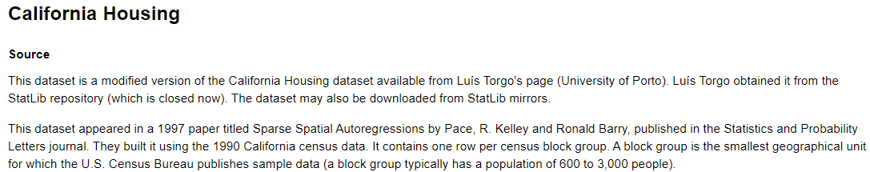
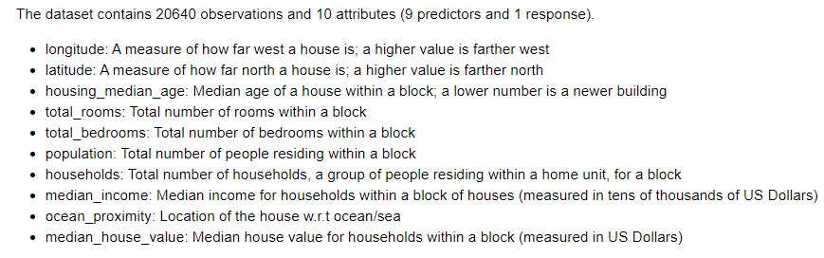
Overview
Input:

Slide 4
Steps:
Overview
To upload Housing_Regression.csv and to read data
To investigate dataset and to do visualisation
To prepare data
To build some regression models and to do tuning of the models
To do ensemble by VotingRegressor
To use RandomForestRegressor and to do tuning of it
To use Gradient Boosting Regressor or AdaBoostRegressor and to do tuning of it

Slide 5
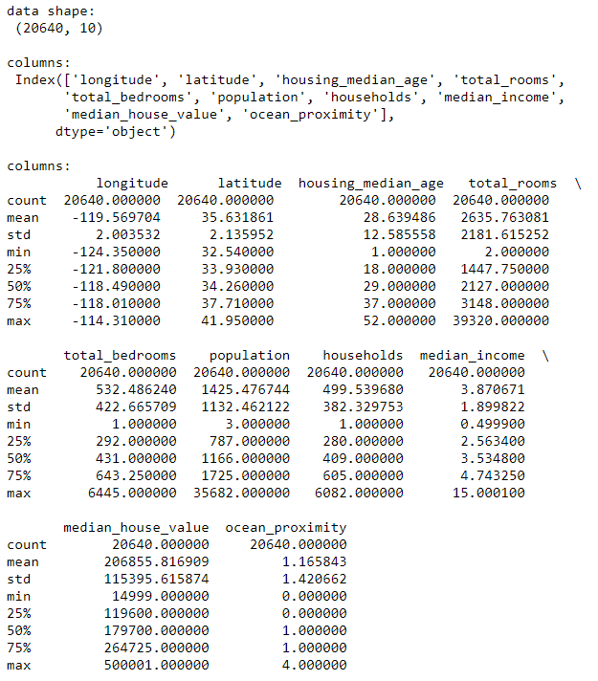
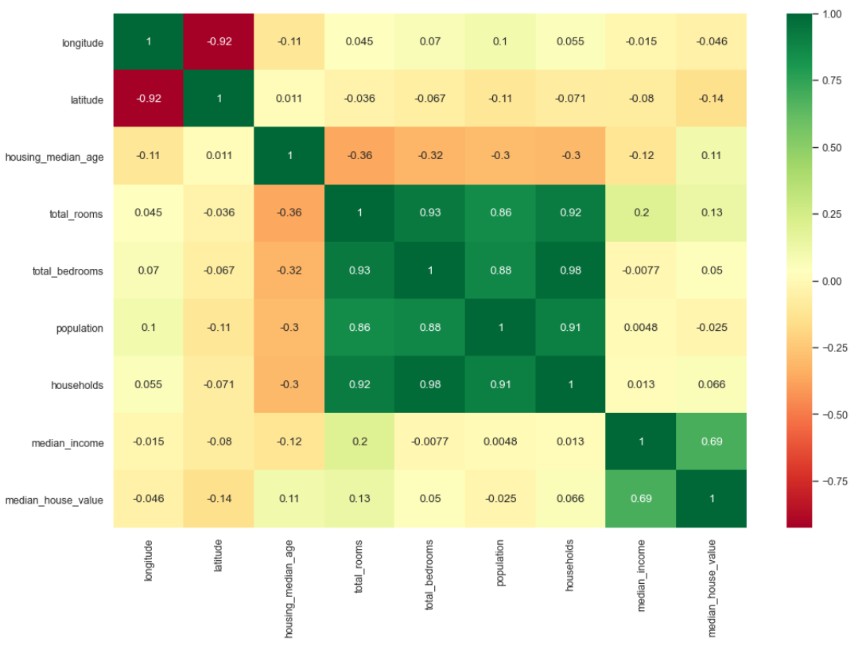
Data analysis, visualization and preparation
Data:
Correlation:

Slide 6
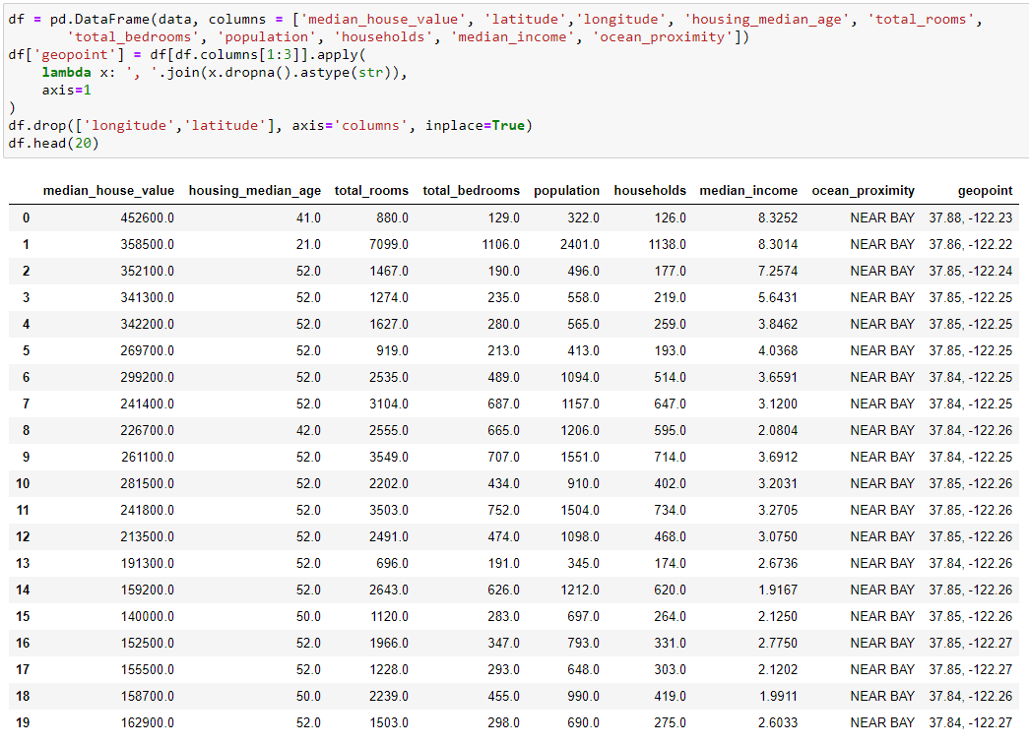
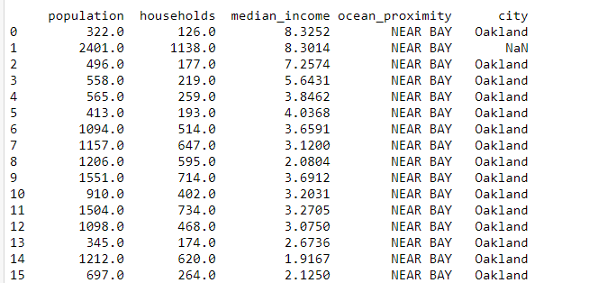
Data analysis, visualization and preparation
Create “geopoints” column instead “lomgitude” and “latitude” and the change it to City by used geopy Liberies

Slide 7
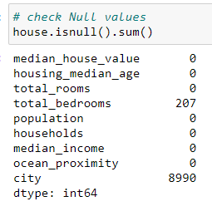
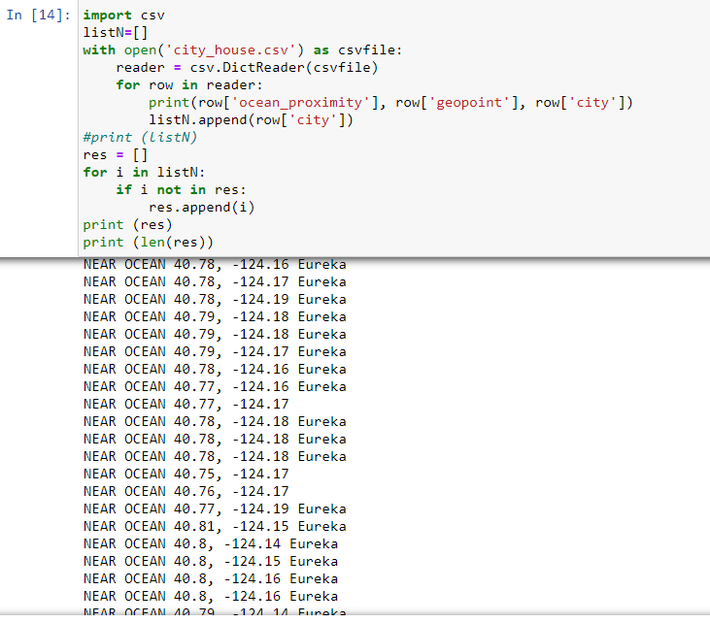
Data analysis, visualization and preparation
Change 0 by 1 (as min value for total_bedrooms)
Change NaN by previous value in the column
(because such trend on the table)

Slide 8
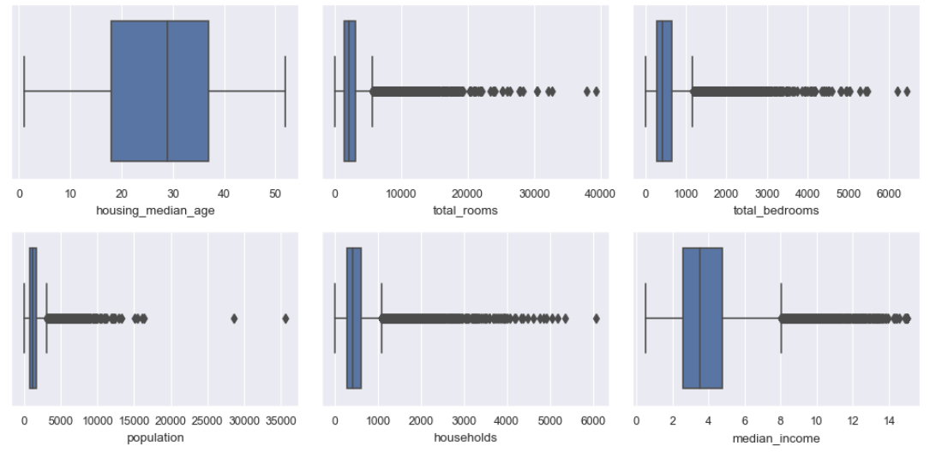
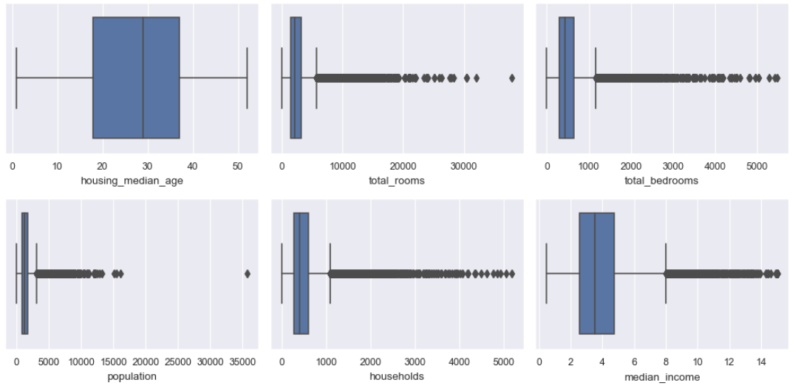
Data analysis, visualization and preparation
Outlier Analysis before IQR:
Outlier Analysis after IQR:

Slide 9
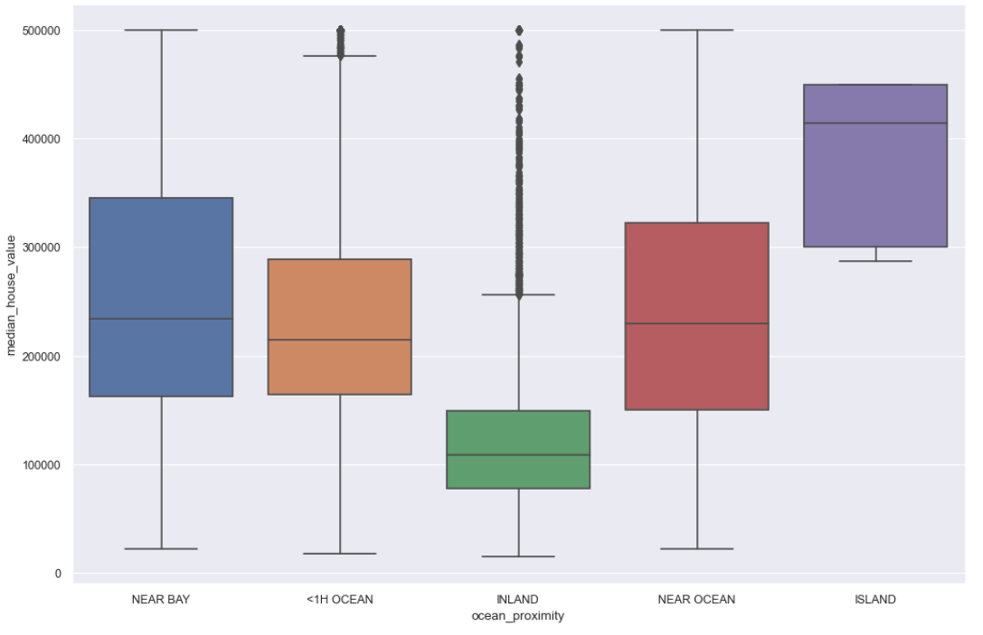
Data analysis, visualization and preparation
Categorical Columns: ocean_proximity

Slide 10
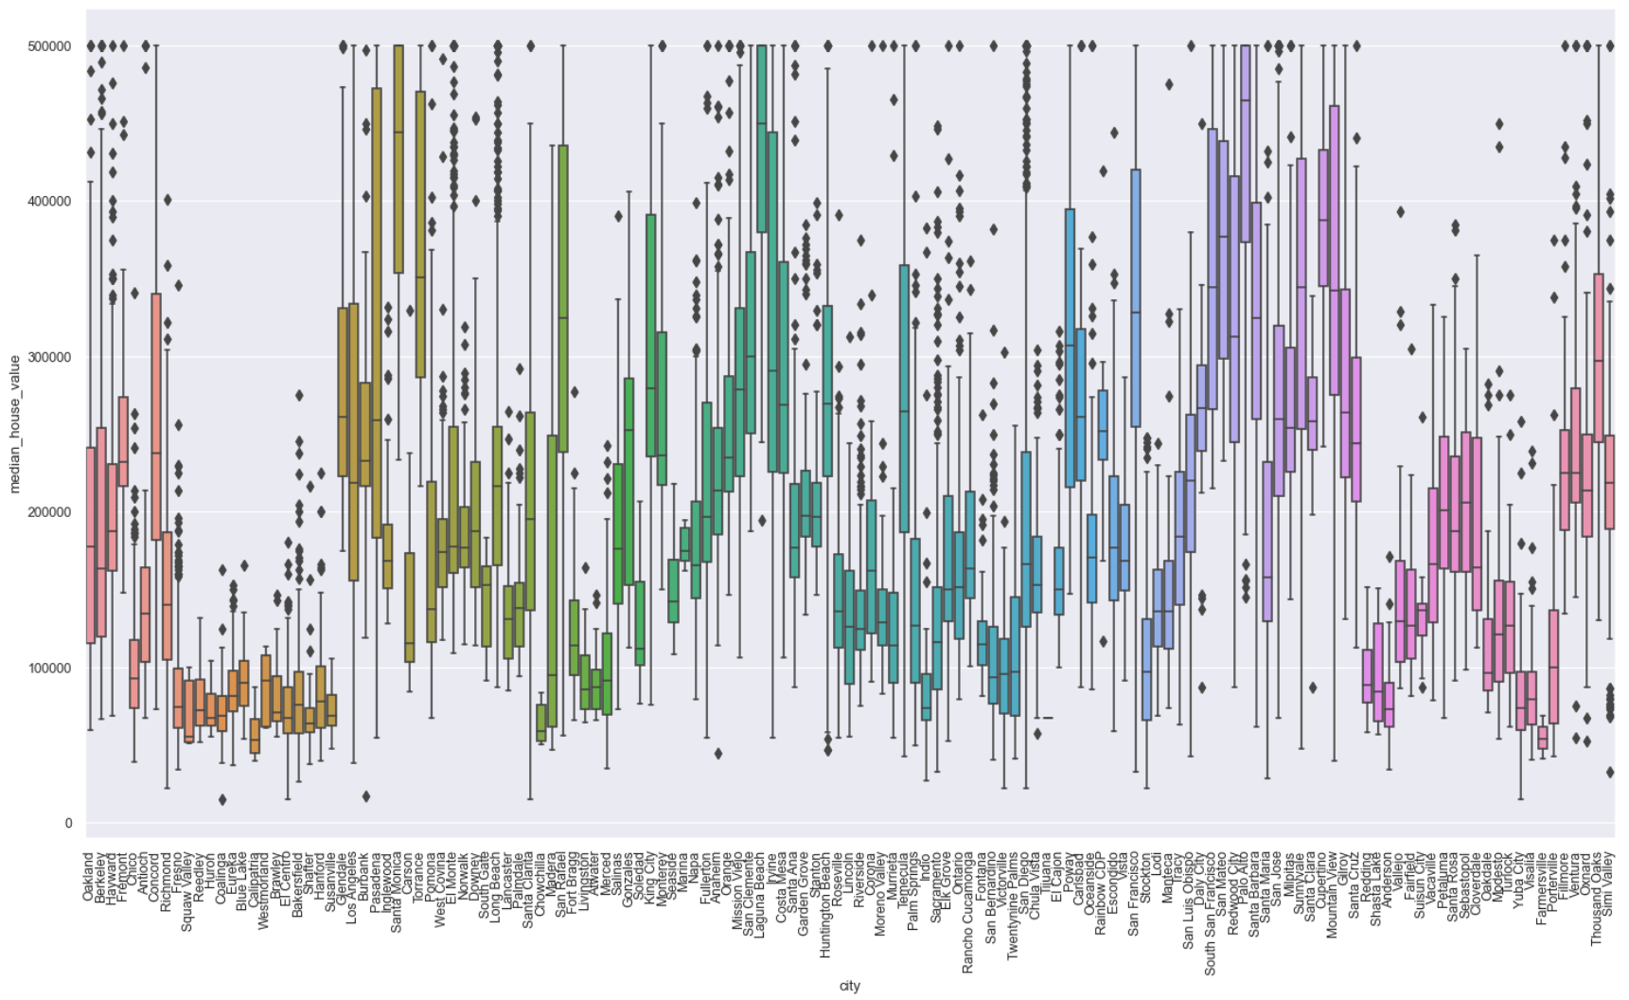
Data analysis, visualization and preparation
Categorical Columns: city

Slide 11
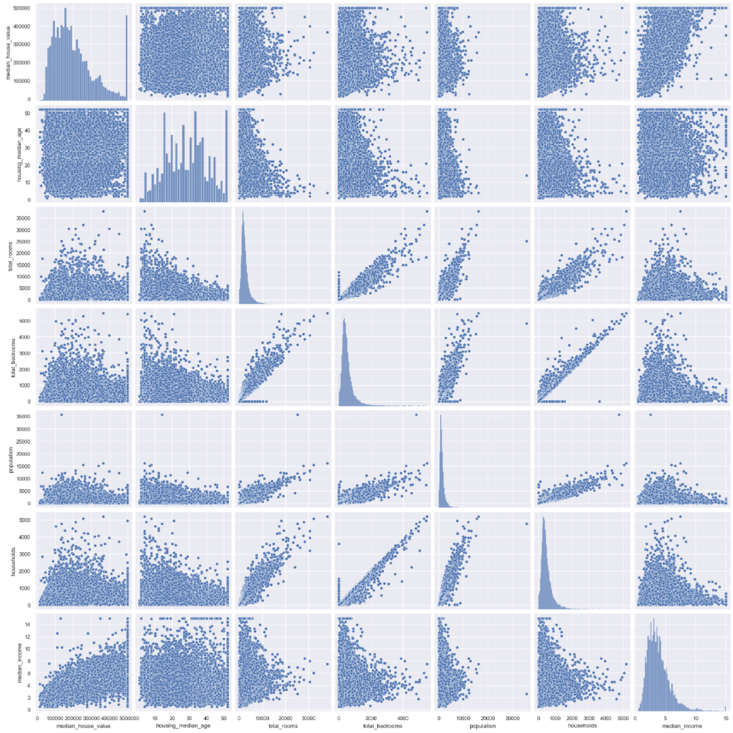
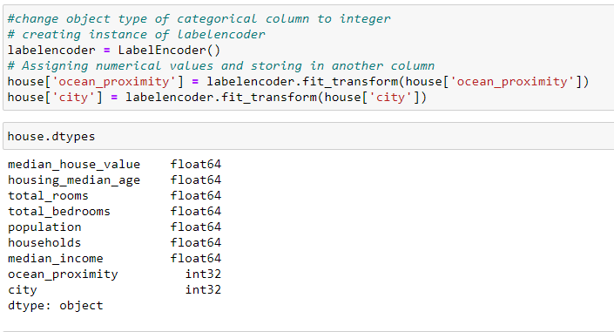
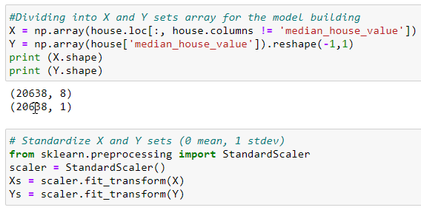
Data analysis, visualization and preparation
Whole dataset:
Categorical to integer
Standardization

Slide 12
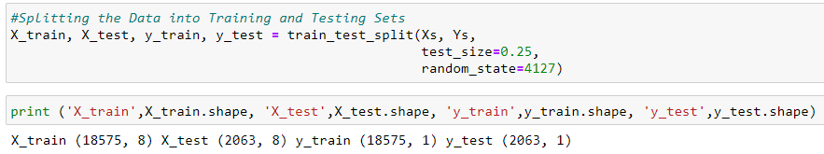
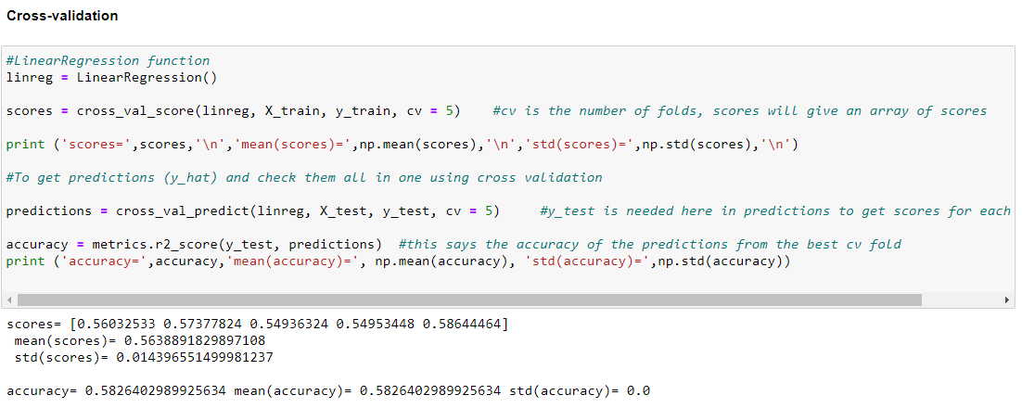
Models
Preparation before the building:
1
2

Slide 13


Cross-validation scores:
Models
LinearRegression()
Ridge()
Lasso()
ElasticNet()

Slide 14




ElasticNet
Models
Ridge Regression

Slide 15


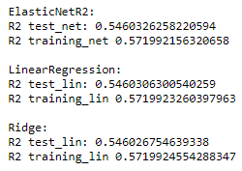

Linear Regression
Models
Voting Regressor

Slide 16




Random Forest
Models
Gradient Boosting Regressor

Slide 17
Conclusion
After Tuning the best model was ElasticNet, LinearRegression, Ridge which give similar R2 scores (about 54%for test and 57%for training).
VotingRegressor of this 3 models does not give better result then Ridge model
After tuning of the RandomForestRegressor R2 scores increased to the next results:
about 71,7% for test and 76,5% for training
The best result give tuning of the GradientBoostingRegressor R2 scores increased to the next result:
about 76,6% for test and 82,3% for training

Slide 18
Questions?

